Slide 1
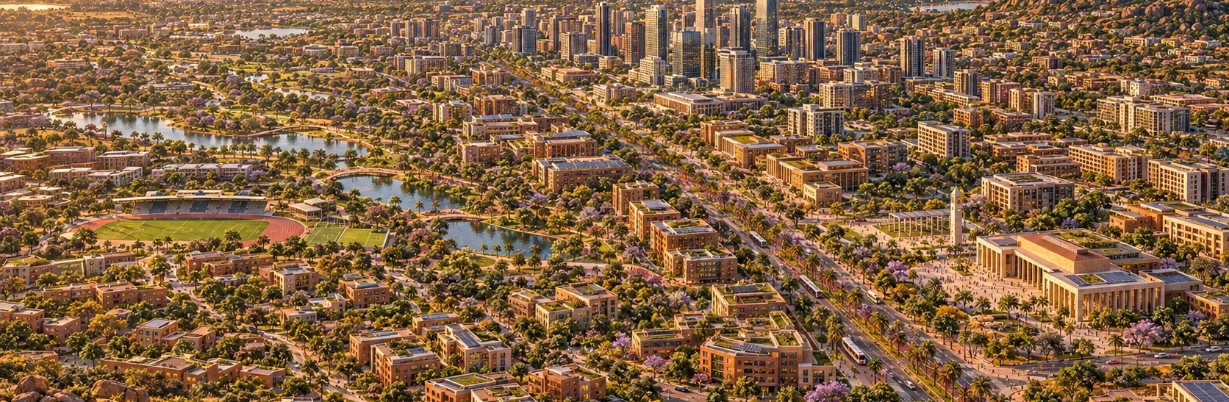
ILLUSTRATIVE CITY VISION
DIASPORA CITY
ZIMBABWE
Reimagining urban development in Zimbabwe
A strategic proposition to the Ministry of Local Government and Public Works
Zimbabweans in Diaspora Organisation (ZIDO)
ZIDO / DIASPORA CITY ZIMBABWE
diasporacityzimbabwe.com
01
Notes:
Source: Diaspora_City_Zimbabwe_Ministry_Presentation(1).pptx, original slide 1.
Original source content:
PRESENTATION TO THE
MINISTRY OF LOCAL GOVERNMENT
AND PUBLIC WORKS
REIMAGINING
URBAN DEVELOPMENT
IN ZIMBABWE
Why a New Diaspora City is a Strategic National Imperative
Beyond repairing existing cities: building the cities of the future
DIASPORA CITY ZIMBABWE
Website: https://diasporacityzimbabwe.com
Illustrative city vision. September 2026.
All project renders are illustrative design concepts created for Diaspora City Zimbabwe. They do not depict a verified site or completed development.

Slide 2
A dual urban strategy
Zimbabwe can regenerate existing cities while creating room for a new generation of planned urban development.
01
02
Regenerate existing cities
Develop Diaspora City
Renew infrastructure and restore the economic vitality of established urban centres.
Create a complementary national project designed around modern housing, infrastructure and productive investment.
ZIDO / DIASPORA CITY ZIMBABWE
diasporacityzimbabwe.com/vision
02
Notes:
Source: Diaspora_City_Zimbabwe_Ministry_Presentation(1).pptx, original slide 2.
Original source content:
Executive Proposition
The strategic question before Zimbabwe
02
Zimbabweans in Diaspora Organisation (ZIDO) | Diaspora City Zimbabwe
REIMAGINING URBAN DEVELOPMENT
Should Zimbabwe continue investing predominantly in repairing urban systems designed over a century ago?
OR
Should Zimbabwe simultaneously create a new generation of world-class cities designed for modern economic realities?
PROPOSITION
Establish a Diaspora City as a national strategic project that complements—not replaces—existing cities.
A DUAL STRATEGY: REGENERATE TODAY'S CITIES + BUILD TOMORROW'S CITIES
Website: https://diasporacityzimbabwe.com/vision
All project renders are illustrative design concepts created for Diaspora City Zimbabwe. They do not depict a verified site or completed development.

Slide 3
The inherited urban model
Zimbabwe’s urban development reflects the functions that originally shaped its towns.
Administrative centres
Governance and colonial administration shaped early urban form.
Industry and extraction
Towns grew around industrial, mining and agricultural activity.
Rail and transport
Transport connections determined where settlements and commerce developed.
Harare, founded as Salisbury in 1890, developed as an administrative centre. Today’s requirements extend beyond that original planning context.
ZIDO / DIASPORA CITY ZIMBABWE
diasporacityzimbabwe.com/vision
03
Notes:
Source: Diaspora_City_Zimbabwe_Ministry_Presentation(1).pptx, original slide 3.
Original source content:
How Zimbabwean Cities Were Originally Formed
Historical context and the inherited urban model
03
Zimbabweans in Diaspora Organisation (ZIDO) | Diaspora City Zimbabwe
REIMAGINING URBAN DEVELOPMENT
01
Administrative centres
Designed around governance and colonial administration.
02
Industrial support towns
Built to service industrial and extractive activity.
03
Railway & mining nodes
Connected to transport, mining and agricultural systems.
HARARE • SALISBURY
Founded in 1890 primarily as an administrative centre. Its planning logic reflected the priorities of its era—not the requirements of a modern, globally competitive investment city.
The inherited city was not designed around today's population, economic model or investment needs.
Website: https://diasporacityzimbabwe.com/vision
Harare, founded as Salisbury in 1890, developed as an administrative centre. Today’s requirements extend beyond that original planning context.
All project renders are illustrative design concepts created for Diaspora City Zimbabwe. They do not depict a verified site or completed development.

Slide 4
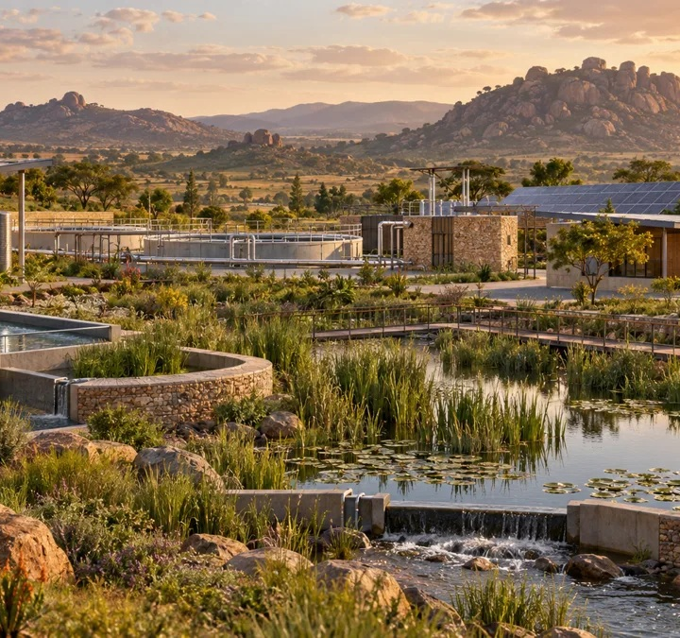
Urban capacity under pressure
The challenge concerns structural capacity as well as management.
Population and housing
Growth has exceeded the assumptions behind older city plans.
Infrastructure
Existing networks need upgrades and expansion to meet demand.
Planning capacity
Inherited frameworks and delayed expansion leave services responding after pressure emerges.
ILLUSTRATIVE CONCEPT
Concept image shows a proposed future system. Existing urban capacity requires local assessment.
ZIDO / DIASPORA CITY ZIMBABWE
diasporacityzimbabwe.com/vision
04
Notes:
Source: Diaspora_City_Zimbabwe_Ministry_Presentation(1).pptx, original slide 4.
Original source content:
The Structural Problem
Cities designed for yesterday
04
Zimbabweans in Diaspora Organisation (ZIDO) | Diaspora City Zimbabwe
REIMAGINING URBAN DEVELOPMENT
The challenge is not merely management.
The challenge is structural capacity.
• Planning frameworks remain influenced by inherited legislation and standards.
• Urban systems have struggled to adapt to rapid population growth.
• Harare was planned for a much smaller population than it accommodates today.
• Housing, infrastructure and services are under increasing pressure.
Population
Urban growth outpaces original planning assumptions.
Infrastructure
Legacy systems require costly upgrades and expansion.
Capacity
New demand is often met after pressure has already emerged.
Website: https://diasporacityzimbabwe.com/vision
Concept image shows a proposed future system. Existing urban capacity requires local assessment.
All project renders are illustrative design concepts created for Diaspora City Zimbabwe. They do not depict a verified site or completed development.

Slide 5
Four reinforcing pressures
The case for new capacity sits alongside the continuing need to maintain and improve existing cities.
Population growth
Urbanisation increases demand for housing and services.
Ageing infrastructure
Water, sewerage, roads and drainage require sustained renewal.
Economic informality
Trading patterns reflect wider employment and economic pressures.
Planning backlogs
Delayed expansion contributes to unplanned growth at the urban edge.
ZIDO / DIASPORA CITY ZIMBABWE
diasporacityzimbabwe.com/vision
05
Notes:
Source: Diaspora_City_Zimbabwe_Ministry_Presentation(1).pptx, original slide 5.
Original source content:
Why Existing Cities Are Under Stress
Four reinforcing urban pressures
05
Zimbabweans in Diaspora Organisation (ZIDO) | Diaspora City Zimbabwe
REIMAGINING URBAN DEVELOPMENT
↑
Population Growth
Increasing urbanisation
Housing demand exceeding supply
↻
Infrastructure Ageing
Water • sewer • roads • drainage
≈
Informalisation
Informal trading reflects wider employment and economic pressures.
!
Planning Backlogs
Delayed expansion • slow renewal • unplanned peripheral growth
URBAN PRESSURE IS A SYSTEMIC CAPACITY ISSUE — NOT SIMPLY A MAINTENANCE ISSUE
Website: https://diasporacityzimbabwe.com/vision
All project renders are illustrative design concepts created for Diaspora City Zimbabwe. They do not depict a verified site or completed development.

Slide 6
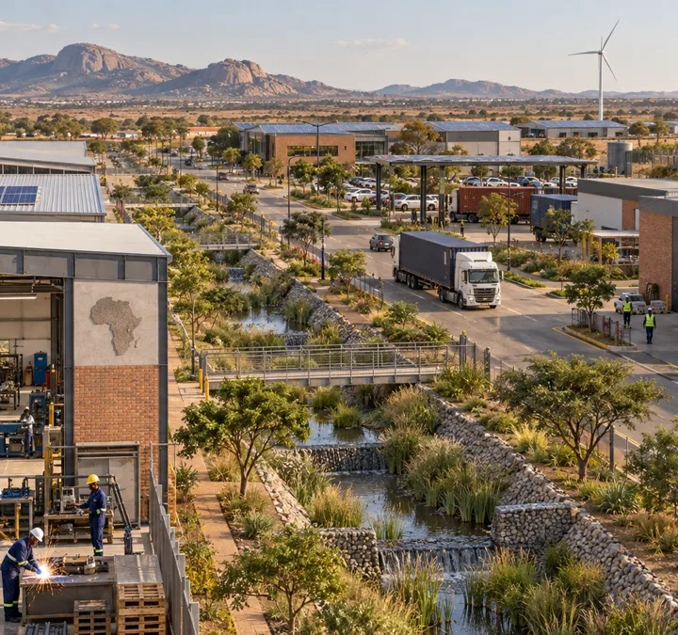
A stronger productive economy
A city needs productive investment alongside the consumption of goods and services.
The concern
Limited industrial growth and weaker private investment can reduce urban productivity.
The proposed response
Plan space for enterprise, services and productive activity alongside housing.
The investment test
Activities must demonstrate demand, infrastructure needs and commercial viability.
ILLUSTRATIVE CONCEPT
ZIDO / DIASPORA CITY ZIMBABWE
diasporacityzimbabwe.com/business
06
Notes:
Source: Diaspora_City_Zimbabwe_Ministry_Presentation(1).pptx, original slide 6.
Original source content:
The Rise of the “Consumption City”
When urban centres consume more than they produce
06
Zimbabweans in Diaspora Organisation (ZIDO) | Diaspora City Zimbabwe
REIMAGINING URBAN DEVELOPMENT
Many urban centres increasingly function as consumption centres rather than production centres.
•
Limited industrial expansion
•
Declining CBD investment
•
Buildings converted to low-value uses
•
Reduced private-sector confidence
•
Informal occupation of prime urban space
Lower productivity + weaker investor attractiveness = a cycle that becomes harder to reverse.
Website: https://diasporacityzimbabwe.com/business
All project renders are illustrative design concepts created for Diaspora City Zimbabwe. They do not depict a verified site or completed development.

Slide 7
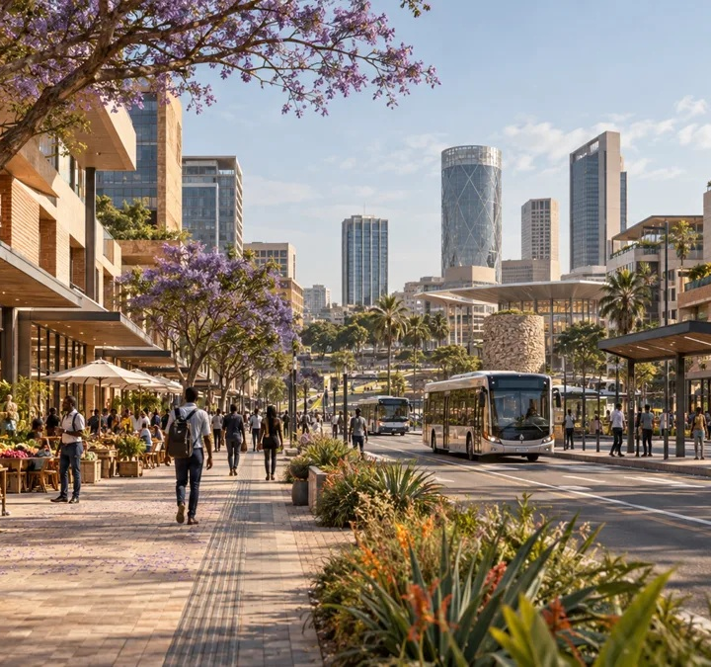
The case for CBD renewal
Underused buildings and declining city centre vitality call for sustained reinvestment.
Buildings and access
Ageing stock and parking constraints can reduce competitiveness.
Business location
Companies may favour modern suburban workplaces.
Urban quality and investment
Safety, maintenance and investment incentives affect the attractiveness of city centres.
ILLUSTRATIVE CONCEPT
The concept image illustrates future business space, not the condition of an existing CBD.
ZIDO / DIASPORA CITY ZIMBABWE
diasporacityzimbabwe.com/business
07
Notes:
Source: Diaspora_City_Zimbabwe_Ministry_Presentation(1).pptx, original slide 7.
Original source content:
Why CBDs Are Losing Value
The emerging “ghost building” phenomenon
07
Zimbabweans in Diaspora Organisation (ZIDO) | Diaspora City Zimbabwe
REIMAGINING URBAN DEVELOPMENT
1
Remote Business Migration
Companies relocate to suburban office parks.
2
Ageing Building Stock
Many buildings require significant upgrading.
3
Parking Constraints
CBD infrastructure struggles to meet modern demand.
4
Safety & Urban Quality
Poor maintenance reduces attractiveness.
5
Reduced Investment Incentives
Private capital seeks modern developments elsewhere.
RESULT
Underutilised urban assets • declining city-centre vitality • weaker private investment
Website: https://diasporacityzimbabwe.com/business
The concept image illustrates future business space, not the condition of an existing CBD.
All project renders are illustrative design concepts created for Diaspora City Zimbabwe. They do not depict a verified site or completed development.

Slide 8
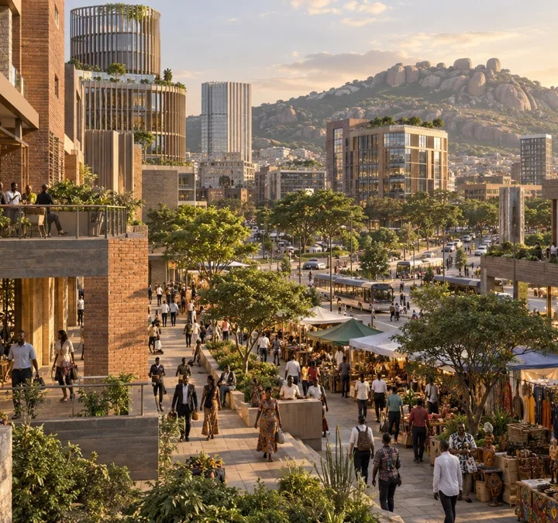
Economic life in urban centres
“Urban desertification” describes a decline in economic activity and urban vitality.
The warning signs
Vacant properties, fewer residents and reduced urban vibrancy.
The reinforcing pattern
Lower activity can discourage reinvestment and further weaken demand.
The policy response
Reinvestment in older centres remains part of the wider urban strategy.
ILLUSTRATIVE CONCEPT
Economic desertification is a metaphor here, not an ecological assessment.
ZIDO / DIASPORA CITY ZIMBABWE
diasporacityzimbabwe.com/vision
08
Notes:
Source: Diaspora_City_Zimbabwe_Ministry_Presentation(1).pptx, original slide 8.
Original source content:
Desertification of Urban Centres
Economic desertification—not ecological desertification
08
Zimbabweans in Diaspora Organisation (ZIDO) | Diaspora City Zimbabwe
REIMAGINING URBAN DEVELOPMENT
What does urban desertification mean?
Reduced economic activity
Vacant properties
Declining investment
Loss of residents
Reduced urban vibrancy
Vacancy
Less Investment
Lower Activity
Fewer Residents
Without reinvestment, parts of older urban areas can become economically stagnant.
Website: https://diasporacityzimbabwe.com/vision
Economic desertification is a metaphor here, not an ecological assessment.
All project renders are illustrative design concepts created for Diaspora City Zimbabwe. They do not depict a verified site or completed development.

Slide 9
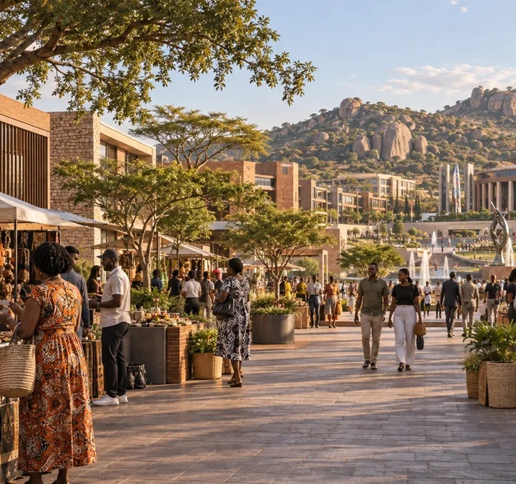
Space for everyday urban life
Pedestrians, transport, traders and businesses need a city that has room for them.
Underlying pressures
Unemployment, housing shortages and economic informality shape demand for space.
A planning response
Provide designated trading infrastructure, connected streets and accessible public space.
The principle
Urban capacity and infrastructure must support the people who use the city.
ILLUSTRATIVE CONCEPT
ZIDO / DIASPORA CITY ZIMBABWE
diasporacityzimbabwe.com/living
09
Notes:
Source: Diaspora_City_Zimbabwe_Ministry_Presentation(1).pptx, original slide 9.
Original source content:
Overcrowding and Urban Disorder
A planning and capacity perspective
09
Zimbabweans in Diaspora Organisation (ZIDO) | Diaspora City Zimbabwe
REIMAGINING URBAN DEVELOPMENT
Competition for urban space
Pedestrians
Transport
Traders
Businesses
Underlying causes
• Unemployment
• Housing shortages
• Economic informality
• Limited designated trading infrastructure
The issue is not people.
The issue is insufficient urban capacity and infrastructure.
Website: https://diasporacityzimbabwe.com/living
All project renders are illustrative design concepts created for Diaspora City Zimbabwe. They do not depict a verified site or completed development.

Slide 10
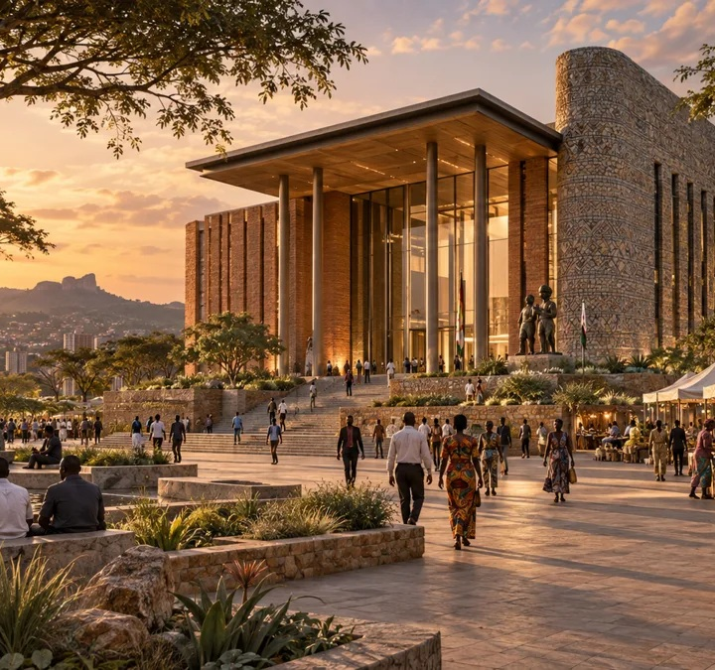
The challenge of retrofitting
Upgrading a built city can involve buried networks, scarce land and disruption to established uses.
Infrastructure and land
Replace existing networks and negotiate space for expansion.
Communities and businesses
Manage relocation, construction access and disruption.
A complementary option
Assess where planned greenfield development can provide new capacity efficiently.
ILLUSTRATIVE CONCEPT
Relative cost and efficiency require site specific feasibility and comparison with regeneration options.
ZIDO / DIASPORA CITY ZIMBABWE
diasporacityzimbabwe.com/city
10
Notes:
Source: Diaspora_City_Zimbabwe_Ministry_Presentation(1).pptx, original slide 10.
Original source content:
Why Fixing Existing Cities Alone Is Not Enough
The cost of retrofitting
10
Zimbabweans in Diaspora Organisation (ZIDO) | Diaspora City Zimbabwe
REIMAGINING URBAN DEVELOPMENT
1
Replace buried infrastructure
Major works beneath built-up areas.
2
Acquire expensive land
Limited space and high opportunity cost.
3
Relocate existing uses
Political, commercial and social disruption.
4
Manage disruption
Construction affects established communities and businesses.
In many cases, modern infrastructure can be delivered more efficiently through planned greenfield development.
Website: https://diasporacityzimbabwe.com/city
Relative cost and efficiency require site specific feasibility and comparison with regeneration options.
All project renders are illustrative design concepts created for Diaspora City Zimbabwe. They do not depict a verified site or completed development.

Slide 11
International reference points
Six international reference points for studying new city development as a national policy instrument.
Brasília
Putrajaya
Songdo
Brazil
Malaysia
South Korea
Konza Technopolis
Eko Atlantic
New Administrative Capital
Kenya
Nigeria
Egypt
These are reference cases, not proof of equivalent outcomes. Governance, finance, demand and delivery need separate review for Zimbabwe.
ZIDO / DIASPORA CITY ZIMBABWE
diasporacityzimbabwe.com/vision
11
Notes:
Source: Diaspora_City_Zimbabwe_Ministry_Presentation(1).pptx, original slide 11.
Original source content:
Lessons from Global Cities
Successful nations have used new-city development to overcome urban constraints
11
Zimbabweans in Diaspora Organisation (ZIDO) | Diaspora City Zimbabwe
REIMAGINING URBAN DEVELOPMENT
1
Brasília
Brazil
New-city development created room for modern infrastructure, investment and economic functions.
2
Putrajaya
Malaysia
New-city development created room for modern infrastructure, investment and economic functions.
3
Songdo
South Korea
New-city development created room for modern infrastructure, investment and economic functions.
4
Konza Technopolis
Kenya
New-city development created room for modern infrastructure, investment and economic functions.
5
Eko Atlantic
Nigeria
New-city development created room for modern infrastructure, investment and economic functions.
6
New Administrative Capital
Egypt
New-city development created room for modern infrastructure, investment and economic functions.
THE LESSON: NEW CITIES CAN BE A COMPLEMENTARY NATIONAL DEVELOPMENT INSTRUMENT
Website: https://diasporacityzimbabwe.com/vision
These are reference cases, not proof of equivalent outcomes. Governance, finance, demand and delivery need separate review for Zimbabwe.
All project renders are illustrative design concepts created for Diaspora City Zimbabwe. They do not depict a verified site or completed development.

Slide 12
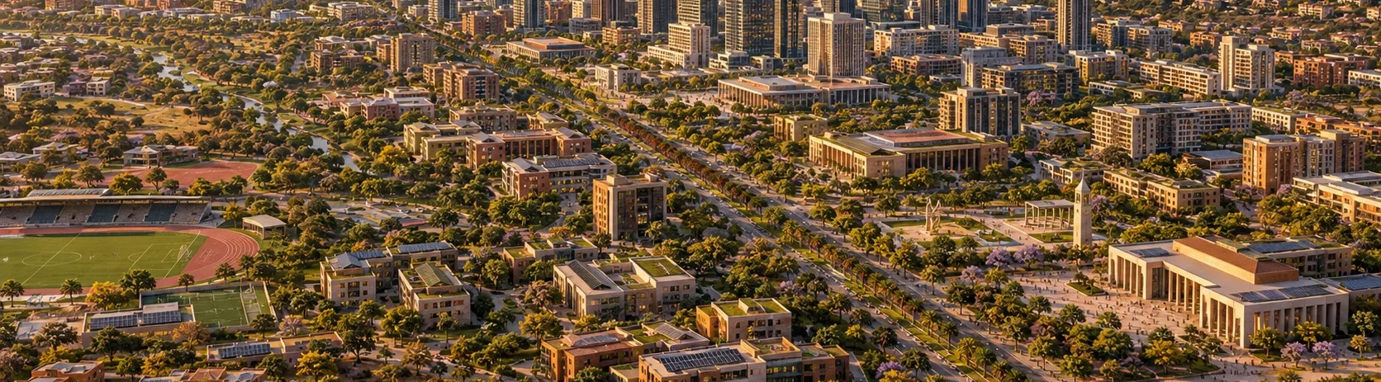
The Diaspora City proposition
An integrated city planned around modern economic and social needs.
ILLUSTRATIVE CONCEPT
Master planning
Smart systems
Infrastructure
Investment
Sustainability
Coherent land use
Digital foundations
Utilities before growth
Viable economic activity
Resilient resource use
ZIDO / DIASPORA CITY ZIMBABWE
diasporacityzimbabwe.com/city
12
Notes:
Source: Diaspora_City_Zimbabwe_Ministry_Presentation(1).pptx, original slide 12.
Original source content:
The Diaspora City Solution
A new urban development model
12
Zimbabweans in Diaspora Organisation (ZIDO) | Diaspora City Zimbabwe
REIMAGINING URBAN DEVELOPMENT
MASTER PLANNED
Coherent land use from day one.
SMART-CITY ENABLED
Digital systems embedded at inception.
INFRASTRUCTURE-FIRST
Utilities and transport planned before scale-up.
INVESTMENT-LED
Designed around bankable economic activity.
SUSTAINABLE
Efficient, resilient and environmentally responsible.
Design the city around modern economic needs — rather than forcing modern needs into yesterday’s urban form.
Website: https://diasporacityzimbabwe.com/city
All project renders are illustrative design concepts created for Diaspora City Zimbabwe. They do not depict a verified site or completed development.

Slide 13
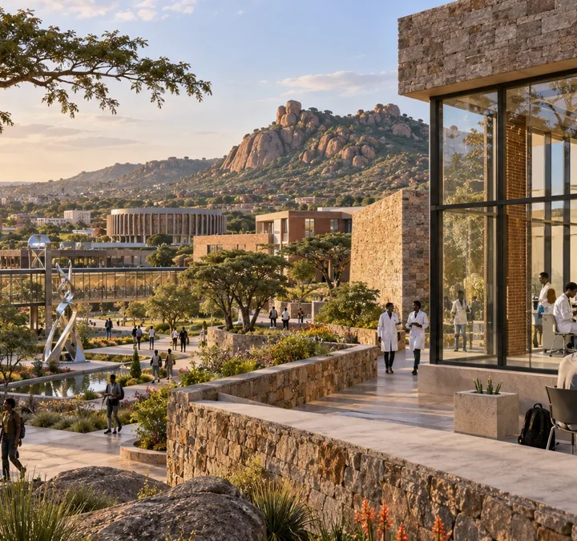
Diaspora participation
Zimbabwe’s global community can contribute investment, professional skills, technology, networks and entrepreneurship.
The opportunity
Connect diaspora interest to productive projects in Zimbabwe.
The trust requirement
Establish professional governance and transparent development structures.
The conditions to resolve
Secure suitable land and define an accountable investment vehicle and participation terms.
ILLUSTRATIVE CONCEPT
Land security and investment arrangements are requirements to establish, not confirmed project achievements.
ZIDO / DIASPORA CITY ZIMBABWE
diasporacityzimbabwe.com/investment
13
Notes:
Source: Diaspora_City_Zimbabwe_Ministry_Presentation(1).pptx, original slide 13.
Original source content:
Why Diaspora Capital Matters
Turning global Zimbabwean networks into productive domestic investment
13
Zimbabweans in Diaspora Organisation (ZIDO) | Diaspora City Zimbabwe
REIMAGINING URBAN DEVELOPMENT
$
Capital
Investment capacity and long-term savings.
★
Skills
Professional and technical expertise.
⚙
Technology
Knowledge transfer and modern systems.
◎
Global Networks
International business relationships.
↗
Entrepreneurship
Business formation and innovation.
The challenge
Create a trusted investment vehicle that converts diaspora interest into transparent, professionally governed projects.
DIASPORA CITY PROVIDES
• Secure land
• Professional governance
• Transparent development structures
• Long-term investment opportunities
Website: https://diasporacityzimbabwe.com/investment
Land security and investment arrangements are requirements to establish, not confirmed project achievements.
All project renders are illustrative design concepts created for Diaspora City Zimbabwe. They do not depict a verified site or completed development.

Slide 14
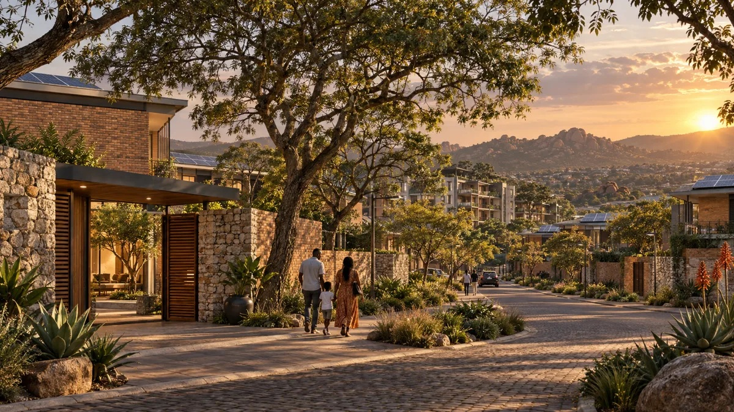
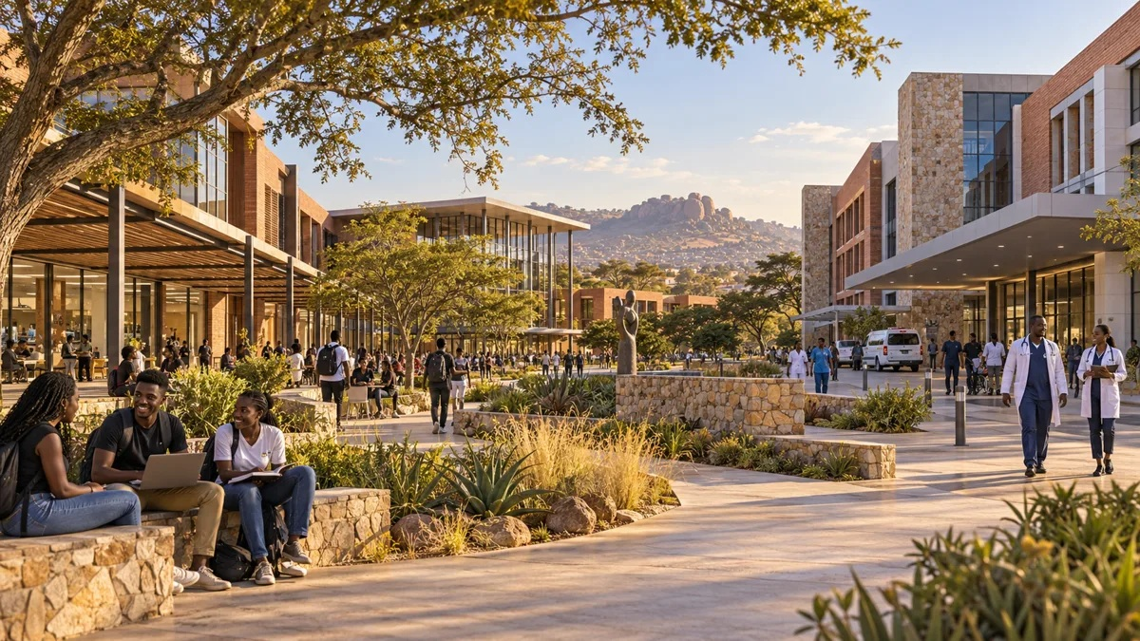
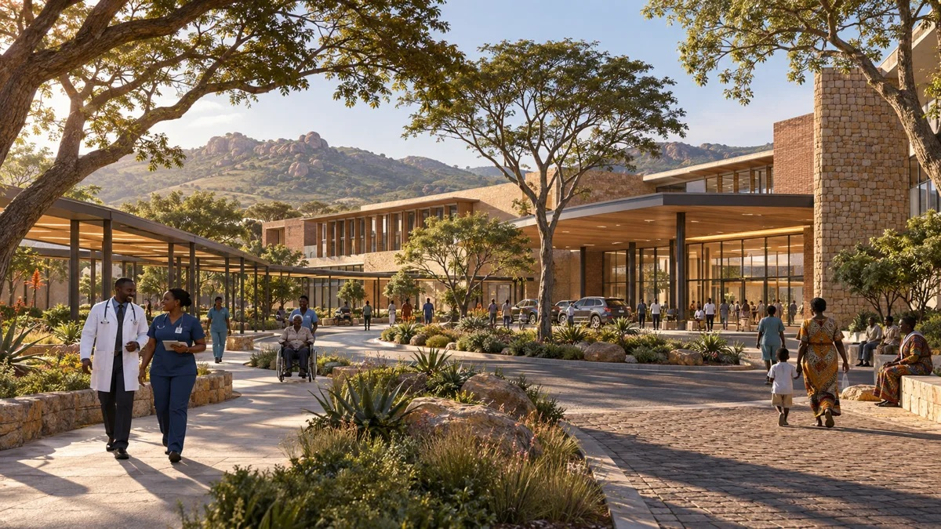
Live. Work. Learn. Heal. Play.
The city proposition connects daily life with economic opportunity.
Illustrative residential, education and healthcare concepts
LIVE
WORK
LEARN
HEAL
PLAY
Modern housing and walkable neighbourhoods
Business districts and innovation hubs
Universities and research centres
High quality healthcare
Parks, sport and entertainment
ZIDO / DIASPORA CITY ZIMBABWE
diasporacityzimbabwe.com/city
14
Notes:
Source: Diaspora_City_Zimbabwe_Ministry_Presentation(1).pptx, original slide 14.
Original source content:
What Makes a World-Class City?
An integrated city where people can live, work, learn, heal and play
14
Zimbabweans in Diaspora Organisation (ZIDO) | Diaspora City Zimbabwe
REIMAGINING URBAN DEVELOPMENT
⌂
LIVE
Modern housing
Walkable neighbourhoods
▣
WORK
Business districts
Innovation hubs
◆
LEARN
Universities
Research centres
+
HEAL
International-standard healthcare
●
PLAY
Parks • sports • entertainment
THE CITY BECOMES AN ECONOMIC ECOSYSTEM — NOT JUST A RESIDENTIAL DEVELOPMENT
Website: https://diasporacityzimbabwe.com/city
All project renders are illustrative design concepts created for Diaspora City Zimbabwe. They do not depict a verified site or completed development.

Slide 15
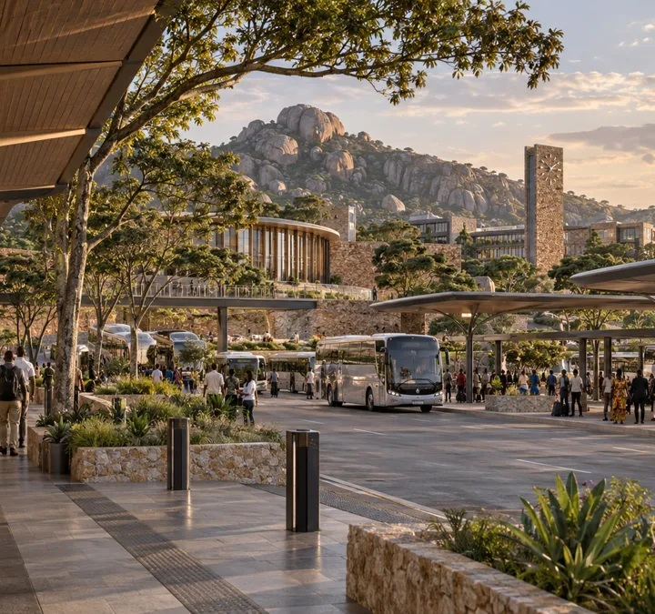
Infrastructure planned together
The strategic intent is to embed modern systems from the outset.
Connected city
Fibre connectivity, digital governance and smart security.
Resource systems
Renewable energy and smart water management.
Movement
Integrated public transport coordinated with land use and growth.
ILLUSTRATIVE CONCEPT
Design, capacity, cost and servicing commitments remain subject to feasibility and approvals.
ZIDO / DIASPORA CITY ZIMBABWE
diasporacityzimbabwe.com/sustainability
15
Notes:
Source: Diaspora_City_Zimbabwe_Ministry_Presentation(1).pptx, original slide 15.
Original source content:
Smart Infrastructure
Designing for 2050, not 1950
15
Zimbabweans in Diaspora Organisation (ZIDO) | Diaspora City Zimbabwe
REIMAGINING URBAN DEVELOPMENT
✓
Fibre connectivity
Embedded from inception rather than retrofitted later.
✓
Renewable energy
Embedded from inception rather than retrofitted later.
✓
Smart water systems
Embedded from inception rather than retrofitted later.
✓
Integrated public transport
Embedded from inception rather than retrofitted later.
✓
Digital governance
Embedded from inception rather than retrofitted later.
✓
Smart security systems
Embedded from inception rather than retrofitted later.
Smart systems are easier and cheaper to integrate during initial development than during urban retrofitting.
Website: https://diasporacityzimbabwe.com/sustainability
Design, capacity, cost and servicing commitments remain subject to feasibility and approvals.
All project renders are illustrative design concepts created for Diaspora City Zimbabwe. They do not depict a verified site or completed development.

Slide 16
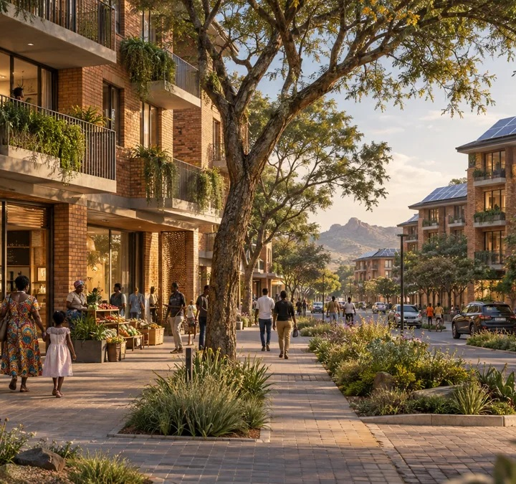
Potential economic contribution
A new city could support national growth through investment, employment and public revenue.
Investment and foreign currency
Diaspora, institutional and international participation could attract capital.
Employment
Construction, technology, services and manufacturing could create work.
Public revenue
Rates, taxes and development levies could broaden revenue sources.
ILLUSTRATIVE CONCEPT
Benefits are proposed outcomes. No jobs forecast, investment return or revenue estimate has been verified.
ZIDO / DIASPORA CITY ZIMBABWE
diasporacityzimbabwe.com/investment
16
Notes:
Source: Diaspora_City_Zimbabwe_Ministry_Presentation(1).pptx, original slide 16.
Original source content:
Economic Impact
A new growth pole for Zimbabwe
16
Zimbabweans in Diaspora Organisation (ZIDO) | Diaspora City Zimbabwe
REIMAGINING URBAN DEVELOPMENT
INVESTMENT ATTRACTION
Diaspora investment
Institutional investment
International partnerships
EMPLOYMENT CREATION
Construction
Technology
Services
Manufacturing
REVENUE GENERATION
Rates
Taxes
Development levies
FOREIGN CURRENCY
Increased inflows
Reduced capital flight
NATIONAL VALUE = INVESTMENT + JOBS + REVENUE + FOREIGN CURRENCY
Website: https://diasporacityzimbabwe.com/investment
Benefits are proposed outcomes. No jobs forecast, investment return or revenue estimate has been verified.
All project renders are illustrative design concepts created for Diaspora City Zimbabwe. They do not depict a verified site or completed development.

Slide 17
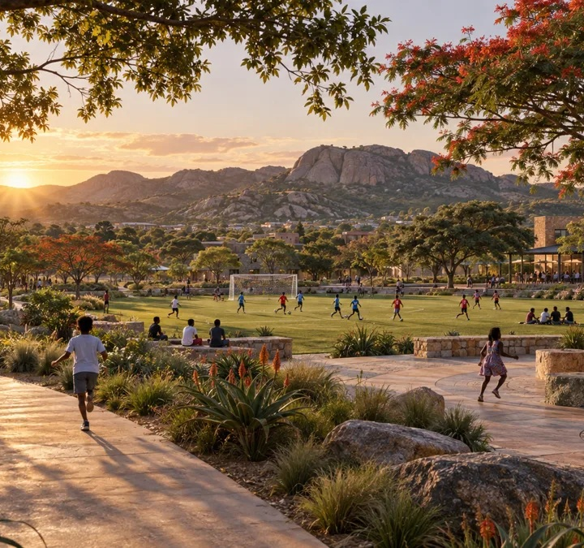
A resilient environmental model
The proposal builds on Zimbabwe’s planning heritage of green space with contemporary resource management.
Energy and water
Explore solar power, water harvesting and reuse.
Natural systems
Protect wetlands and connect green corridors.
Urban forestry
Use trees to support shade, biodiversity and the quality of everyday life.
ILLUSTRATIVE CONCEPT
Environmental baselines, safeguards and performance targets require assessment of a confirmed site.
ZIDO / DIASPORA CITY ZIMBABWE
diasporacityzimbabwe.com/sustainability
17
Notes:
Source: Diaspora_City_Zimbabwe_Ministry_Presentation(1).pptx, original slide 17.
Original source content:
Environmental Benefits
A sustainable urban model
17
Zimbabweans in Diaspora Organisation (ZIDO) | Diaspora City Zimbabwe
REIMAGINING URBAN DEVELOPMENT
●
Solar power
Lower dependence on conventional energy.
●
Water harvesting
Capture and reuse water resources.
●
Wetland protection
Protect natural systems and resilience.
●
Green corridors
Connect communities and ecosystems.
●
Urban forestry
Shade, biodiversity and urban quality.
Zimbabwe already has a planning heritage that valued green space. The opportunity is to build on those principles with contemporary sustainability approaches.
RESILIENT • GREEN • RESOURCE-EFFICIENT
Website: https://diasporacityzimbabwe.com/sustainability
Environmental baselines, safeguards and performance targets require assessment of a confirmed site.
All project renders are illustrative design concepts created for Diaspora City Zimbabwe. They do not depict a verified site or completed development.

Slide 18
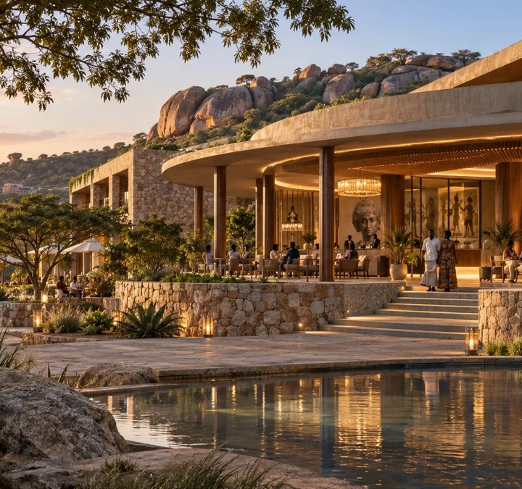
The intended national outcomes
Diaspora City proposes a new focus for planned growth and international engagement.
Urban and housing capacity
Support housing delivery and help reduce pressure on existing cities.
Economic opportunity
Attract investment, encourage innovation and generate employment.
Zimbabwe’s global position
Create a platform for diaspora participation and international visibility.
ILLUSTRATIVE CONCEPT
These are strategic objectives, subject to feasibility, financing and delivery.
ZIDO / DIASPORA CITY ZIMBABWE
diasporacityzimbabwe.com/investment
18
Notes:
Source: Diaspora_City_Zimbabwe_Ministry_Presentation(1).pptx, original slide 18.
Original source content:
Strategic National Outcomes
What Diaspora City can deliver
18
Zimbabweans in Diaspora Organisation (ZIDO) | Diaspora City Zimbabwe
REIMAGINING URBAN DEVELOPMENT
✓
Reduce pressure on existing cities
✓
Create a new economic growth pole
✓
Support housing delivery
✓
Increase foreign investment
✓
Promote innovation
✓
Generate employment
✓
Showcase Zimbabwe internationally
A NEW CITY CAN HELP REBALANCE ZIMBABWE'S URBAN, ECONOMIC AND INVESTMENT GEOGRAPHY
Website: https://diasporacityzimbabwe.com/investment
These are strategic objectives, subject to feasibility, financing and delivery.
All project renders are illustrative design concepts created for Diaspora City Zimbabwe. They do not depict a verified site or completed development.

Slide 19
A national urban strategy
Regeneration and new development can form two coordinated parts of the same policy.
01
02
Existing cities
New urban development
Urban renewal, infrastructure upgrades and CBD regeneration.
Diaspora City, smart city concepts, innovation districts and new economic zones.
The recommendation is to pursue both approaches through appropriate planning and investment decisions.
ZIDO / DIASPORA CITY ZIMBABWE
diasporacityzimbabwe.com/vision
19
Notes:
Source: Diaspora_City_Zimbabwe_Ministry_Presentation(1).pptx, original slide 19.
Original source content:
Recommendation: National Urban Development Strategy
Pursue both regeneration and new-city development
19
Zimbabweans in Diaspora Organisation (ZIDO) | Diaspora City Zimbabwe
REIMAGINING URBAN DEVELOPMENT
1
1. REVITALISE EXISTING CITIES
Urban renewal
Infrastructure upgrades
CBD regeneration
2
2. DEVELOP NEW CITIES
Diaspora City
Smart Cities
Innovation Districts
New Economic Zones
Successful countries pursue both strategies simultaneously.
Website: https://diasporacityzimbabwe.com/vision
The recommendation is to pursue both approaches through appropriate planning and investment decisions.
All project renders are illustrative design concepts created for Diaspora City Zimbabwe. They do not depict a verified site or completed development.

Slide 20
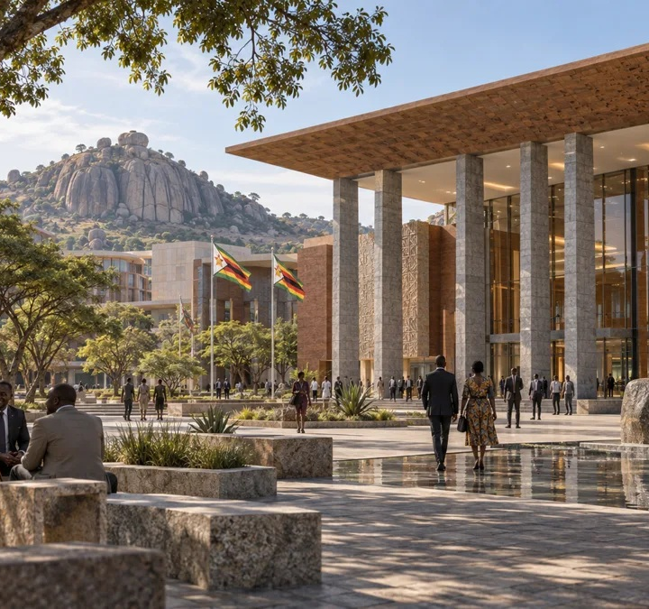
The request to the Ministry
Institutional engagement to move the proposition into feasibility.
01
Recognition as a strategic national project
02
Allocation of suitable land
03
A technical committee involving the relevant stakeholders
04
Support for feasibility and master planning
05
Integration into national urban development policy
ILLUSTRATIVE CONCEPT
Proposed sequence: technical engagement, feasibility, master plan and implementation.
ZIDO / DIASPORA CITY ZIMBABWE
diasporacityzimbabwe.com/about
20
Notes:
Source: Diaspora_City_Zimbabwe_Ministry_Presentation(1).pptx, original slide 20.
Original source content:
Request to the Ministry
Institutional support to move from concept to feasibility
20
Zimbabweans in Diaspora Organisation (ZIDO) | Diaspora City Zimbabwe
REIMAGINING URBAN DEVELOPMENT
✓
Recognition of Diaspora City as a strategic national project.
✓
Allocation of suitable land.
✓
Establishment of a multi-stakeholder technical committee.
✓
Support for a feasibility study and master planning process.
✓
Integration into national urban development policy.
PROPOSED NEXT STEP: TECHNICAL ENGAGEMENT → FEASIBILITY → MASTER PLAN → IMPLEMENTATION
Website: https://diasporacityzimbabwe.com/about
Proposed sequence: technical engagement, feasibility, master plan and implementation.
All project renders are illustrative design concepts created for Diaspora City Zimbabwe. They do not depict a verified site or completed development.

Slide 21
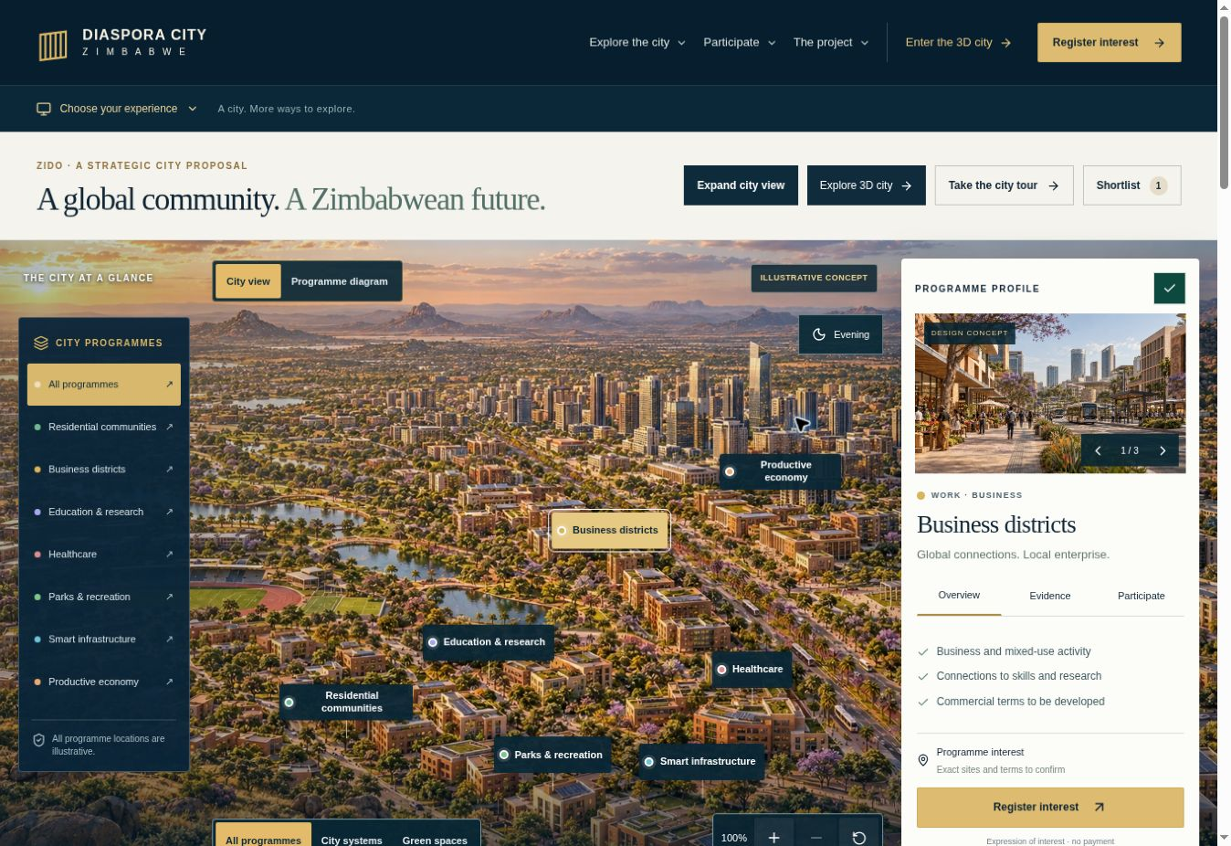
The city is now explorable
The live platform makes the strategic proposition easier to understand and discuss.
Explore programmes
Switch city views, filter programmes and inspect the selected opportunity.
Review the evidence
Read the vision, investment case and project status alongside illustrative imagery.
Live platform view, September 2026. City imagery and spatial locations are illustrative.
ZIDO / DIASPORA CITY ZIMBABWE
diasporacityzimbabwe.com/map
21
Notes:
Source: live Diaspora City Zimbabwe platform and dedicated project implementation, reviewed September 2026.
Website: https://diasporacityzimbabwe.com/map
Live platform view, September 2026. City imagery and spatial locations are illustrative.
All project renders are illustrative design concepts created for Diaspora City Zimbabwe. They do not depict a verified site or completed development.

Slide 22
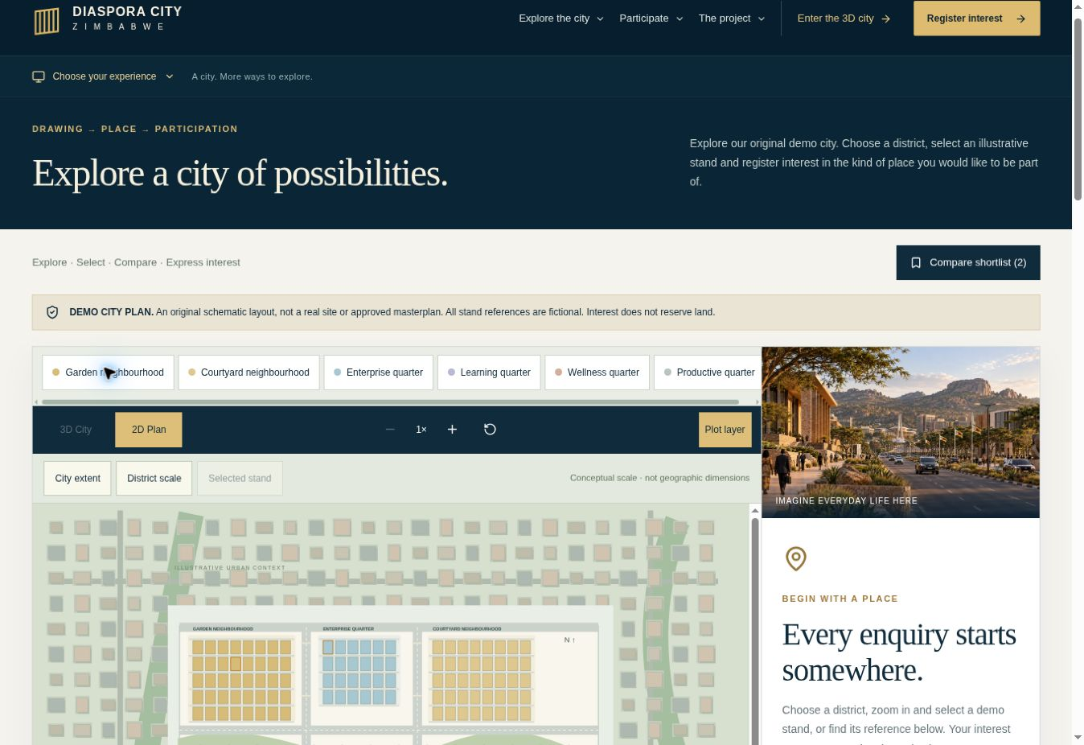
City scale to individual interest
An original demonstration plan connects district exploration to a specific expression of interest.
170 fictional demo stands
Explore districts in 2D or 3D, inspect a selection and save a shortlist.
A connected enquiry
Register interest against a programme or exact demo reference. No payment or exclusive land reservation.
The demo count is a software feature, not land inventory. The scheme is not a surveyed or approved masterplan.
ZIDO / DIASPORA CITY ZIMBABWE
diasporacityzimbabwe.com/city-plan
22
Notes:
Source: live Diaspora City Zimbabwe platform and dedicated project implementation, reviewed September 2026.
Website: https://diasporacityzimbabwe.com/city-plan
The demo count is a software feature, not land inventory. The scheme is not a surveyed or approved masterplan.
All project renders are illustrative design concepts created for Diaspora City Zimbabwe. They do not depict a verified site or completed development.

Slide 23
One platform for participation
The website carries the conversation beyond the presentation.
Explore and select
Review programmes, districts and illustrative opportunities.
Register interest
Provide contact details, your intention and timescale. A stand enquiry retains its demo reference.
Project engagement
The team can review interest and discuss next steps. Verification, agreements and delivery arrangements remain to confirm.
Present together
Choose Tablet presentation or Mobile experience. Full screen is available where the browser supports it.
Public interest counts are a future feature. No demand figures are simulated.
ZIDO / DIASPORA CITY ZIMBABWE
diasporacityzimbabwe.com/opportunities
23
Notes:
Source: live Diaspora City Zimbabwe platform and dedicated project implementation, reviewed September 2026.
Website: https://diasporacityzimbabwe.com/opportunities
Public interest counts are a future feature. No demand figures are simulated.
All project renders are illustrative design concepts created for Diaspora City Zimbabwe. They do not depict a verified site or completed development.

Slide 24
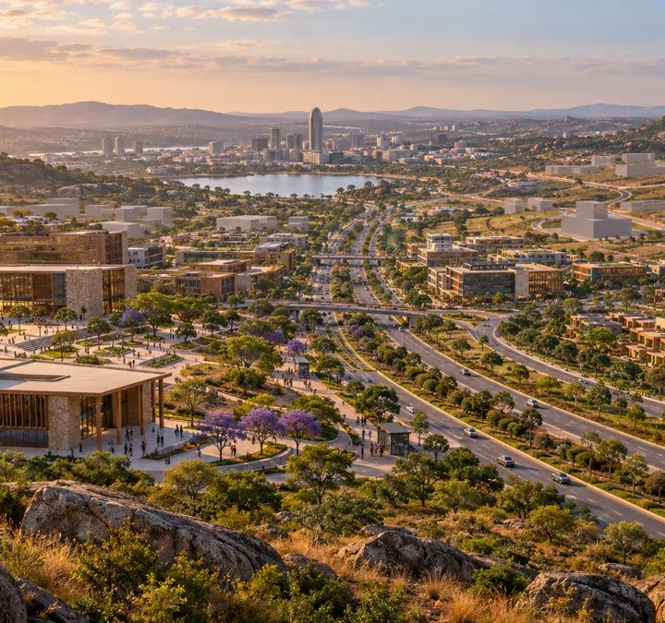
What is ready. What comes next.
A clear distinction between the strategic proposal, the digital experience and development commitments.
Available now
The presentation, concept imagery, interactive city, demo selection and expression of interest journey.
Still to establish
A confirmed site, land rights, approvals, a feasibility case, funding and delivery arrangements.
Before a commercial offer
Verify inventory, prices, servicing, tenure and contractual terms through the project’s professional and institutional processes.
ILLUSTRATIVE CONCEPT
The live platform supports engagement. It does not establish planning approval, land allocation or legal ownership.
ZIDO / DIASPORA CITY ZIMBABWE
diasporacityzimbabwe.com/updates
24
Notes:
Source: live Diaspora City Zimbabwe platform and dedicated project implementation, reviewed September 2026.
Website: https://diasporacityzimbabwe.com/updates
The live platform supports engagement. It does not establish planning approval, land allocation or legal ownership.
All project renders are illustrative design concepts created for Diaspora City Zimbabwe. They do not depict a verified site or completed development.

Slide 25
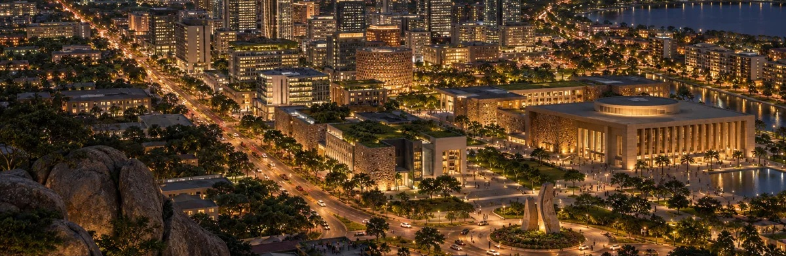
ILLUSTRATIVE CITY VISION
A Zimbabwean future,
shaped together
Diaspora City Zimbabwe
The next step is technical engagement on land, feasibility and a credible route to delivery.
ZIDO / DIASPORA CITY ZIMBABWE
diasporacityzimbabwe.com
25
Notes:
Source: Diaspora_City_Zimbabwe_Ministry_Presentation(1).pptx, original slide 21.
Original source content:
ZIMBABWE HAS REACHED A
DEFINING URBAN MOMENT
The challenge is not merely to repair cities designed for another era.
The challenge is to create cities designed for the future.
DIASPORA CITY ZIMBABWE
A New City. A New Economy. A New Urban Future.
ZIDO • DIASPORA INVESTMENT • PLANNED URBAN GROWTH
Website: https://diasporacityzimbabwe.com
Zimbabweans in Diaspora Organisation (ZIDO)
All project renders are illustrative design concepts created for Diaspora City Zimbabwe. They do not depict a verified site or completed development.

Slide 26
The indicative ZIDO concept
Supporting context from the original proposal
Up to 500 hectares
An indicative development concept. No confirmed boundary or allocated site is established here.
A mixed use community
Housing, commercial activity, schools, healthcare and recreation, supported by integrated infrastructure.
Participation and growth
Mobilise diaspora and local investment, support housing and employment, and facilitate planned economic development.
Source: supplied Ministry presentation, slide 22. The 170 fictional website stands are separate from this indicative land proposition.
ZIDO / DIASPORA CITY ZIMBABWE
diasporacityzimbabwe.com/vision
26
Notes:
Source: Diaspora_City_Zimbabwe_Ministry_Presentation(1).pptx, original slide 22.
Original source content:
Supporting Context from the ZIDO Proposal
Indicative development concept
22
Zimbabweans in Diaspora Organisation (ZIDO) | Diaspora City Zimbabwe
REIMAGINING URBAN DEVELOPMENT
500
UP TO 500 HECTARES
A substantial, master-planned urban development platform.
MIX
MIXED-USE COMMUNITY
Housing • commercial • schools • healthcare • recreation
INFRA
INFRASTRUCTURE
Integrated infrastructure designed for long-term growth.
Investment proposition
• Mobilise diaspora investment
• Support housing delivery
• Create employment
• Promote economic development
• Facilitate planned urban growth
• Create opportunities for diaspora and local investors
Website: https://diasporacityzimbabwe.com/vision
Source: supplied Ministry presentation, slide 22. The 170 fictional website stands are separate from this indicative land proposition.
All project renders are illustrative design concepts created for Diaspora City Zimbabwe. They do not depict a verified site or completed development.

